Slide 1
Libraries
Taking modularity to the next level

Slide 2
Modularity
When architecting software with modularity in mind, some of the pieces become easily reusable.
It makes sense that we might even construct these pieces separate from others and link them together later on.

Slide 3
Libraries
Instead of re-compiling unchanging sections of code over and over, build them once.
The way we link these separate pieces together can be static or dynamic in nature.

Slide 4
Why create a .Lib?
When you are building a collection of functions and/or classes that is meant to be used in one or multiple separate projects
Notes:
The library to be used should have the same project settings as the project in which it is used.
Ex. Single-Threaded or Multi-Threaded Debug
Think of an application that uses a static library like a computer that uses a hard drive. When you turn the computer on, it links to the separate device and does things with it.

Slide 5
Creating a Static Library
Make a simple win32 console app.
Choose the project option for a static library.
Add some functions or classes to your project and then compile.

Slide 6
Linking to the Static Library
Within another solution (or same solution):
Project Properties
Preprocessor Directive
Within the same solution:
Project Reference
Include the main header file which contains the interface to the library.
Notes:
The project dependencies tab allows you to automatically link a library project into another project in the same solution.
The project properties tab allows you to add additional library dependencies (under Linker->Input – Additional Dependencies) and specify additional directories where they may exist (under General – Additional Library Directories)
Alternatively you can use the preprocessor directive like we do in stdafx.h
#pragma comment(lib, "opengl32.lib")
* In VS2010 the project dependencies only affect build order. You need to add a common property reference or manually link using one of the other two options.

Slide 7
Mixing Project Types - Error
defaultlib 'library' conflicts with use of other libs; use /NODEFAULTLIB:library
Make sure the library and regular project are both using the same setting for code generation .
Examples include “Multi-threaded” or “Multi-threaded DLL”
Notes:
This is the error you will receive if you are trying to use projects with different code generation settings.
2008: using project not built with dll
When building libraries, usually build one for debug mode and a separate one for release mode of the application.

Slide 8
Why use a .DLL?
When you are building a collection of functions and/or classes meant to be used with one or more projects.
Which might not have the same project settings
Which might be built using different compilers
You want to be able to change the library without recompiling/restarting the application(s) using it.
Notes:
Many plug-in systems use an API where the plug-in developer must create a DLL using the API, this allows the plug-in developer the potential to create high performance code that can be dynamically loaded by the main application. Examples include Maya, Photoshop, Pidgin, etc.
Think of an application that uses DLL code like a computer that uses hot-swappable hard drives. (or more recently, USB memory sticks)
Imagine you are working in an embedded environment where your .exe takes up 20% of the memory. (PSP for example)
If you can take advantage of unloading some of that code when it is not needed, you can use the memory for other things.
The trade-off here is more CPU overhead used to load/unload the DLL module.
http://mirrors.zoreil.com/webclub.kcom.ne.jp/ma/colinp/win32/dll/intro.html

Slide 9
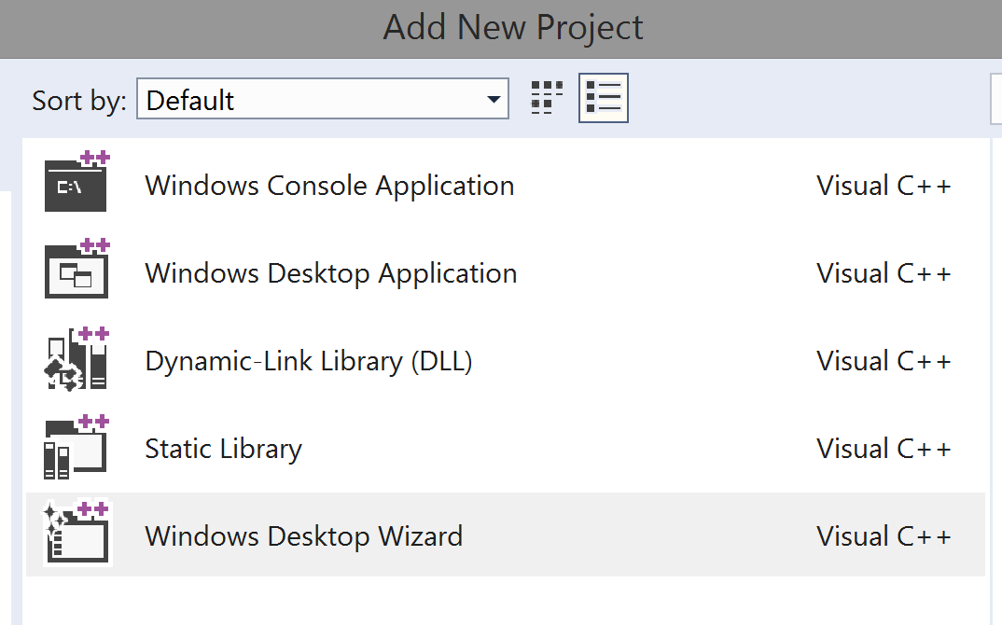
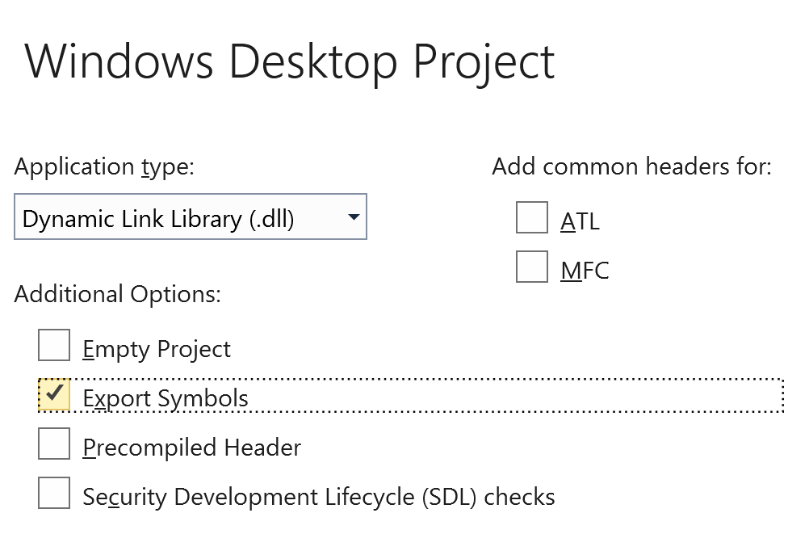
Creating a Dynamic Library
Use the windows desktop wizard.*
Choose the project option for a DLL with exported symbols.
Add some functions or classes to your project and then compile.
Notes:
* In visual studio 2017, if you just pick DLL it will not give you the option for exported symbols.
If you want it to generate the sample code with exported symbols, use the windows desktop wizard instead.
https://blogs.msdn.microsoft.com/vcblog/2017/08/15/changes-to-project-templates-and-code-wizards-in-15-3/

Slide 10
Implicit Linking to the DLL
The compile will produce a .dll file and .lib file which acts as a bridge to the DLL functions.
This .lib (known as an import library) allows you to merely include the header file and call the functions, like a normal library.
Notes:
The functions exported from the DLL are imported by the import library and act as local functions to the project in which it is linked to. (Think of them as proxy functions which bridge into the DLL.)
The .exp file is only used when resolving circular inclusions between DLL functions

Slide 11
Explicit Linking to the DLL
Instead of using a .lib and .h we can manually look up the address of the functions directly from the DLL.
We can then store them in function pointers in our application or call them directly.

Slide 12
Explicit Linking to the DLL
#include <windows.h>
typedef int (*importFunction)();
HINSTANCE hLibrary = LoadLibrary(L"library.dll");
…
importFunction fptr = (importFunction) GetProcAddress(hLibrary, "fnpoi");
…
If(fptr != null)
int x = fptr();
…
FreeLibrary(hLibrary);

Slide 13
Name Decorating (aka Mangling )
When exporting a DLL function we can use the extern “C” directive before the function declaration to disable mangling the function name.
Example:
extern “C” __declspec(dllexport) int print_x();
Notes:
When implicitly linking to a DLL through the use of an import library, we don’t have this problem because it will help translate function calls to their compiled (mangled) names for you.
The only drawback of using extern C is that you can't overload functions (same function name, different parameters).
https://en.wikipedia.org/wiki/Name_mangling
Pragma comment linker - research

Slide 14
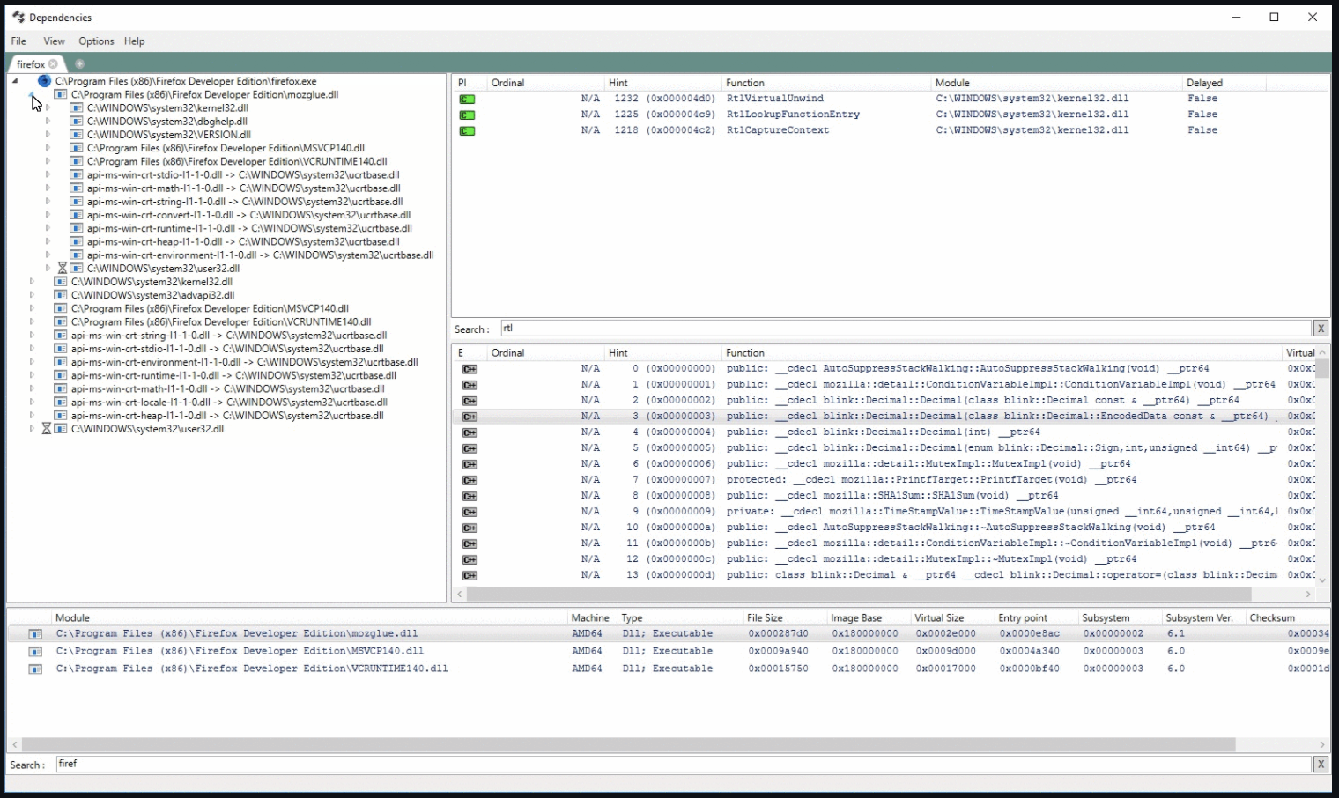
Peeking inside DLLs
An open-source tool called Dependencies allows you to view the exported data in a DLL.
Notes:
https://github.com/lucasg/Dependencies
This can also be done on the command line using the following command:
dumpbin /exports <nameofdll>
https://docs.microsoft.com/en-us/cpp/build/reference/dumpbin-reference – dumpbin usage

Slide 15
Dynamic Library - Issues
A DLL is its own process, and it has its own memory pool. (Hierarchy)
Calling conventions need to be consistent.
When multiple programs use the same DLL, be careful not to upset the mapping of ordinals. (especially for implicit linking)
Notes:
The Law of Demeter is about limiting the scope of modules to provide better structure and prevent problems across boundaries.
It is tied to another concept called RAII (http://en.wikipedia.org/wiki/RAII) and also the OO principle of hierarchy where we determine the assignment location of responsibilities.
https://msdn.microsoft.com/en-us/library/ms235460.aspx
We can use the decorated names to generate a .DEF file to hard code the mapping of function offsets.
This is useful to ensure other programs using the DLL do not break when we add functions to the dll.

Slide 16
Modular APIs
How we make use of modularity to help us with changes to rendering APIs:
The Main Game Application (GTA3.EXE)
Rendering Engine (RenderWare.LIB)
Rendering API (OpenGL32.DLL)
As graphics hardware evolves, so can the DLL.
This way we can take advantage of those changes, without having to recompile the game.
Notes:
Quake links to OpenGL32.DLL at run time to do its rendering

Slide 17
LIB vs. DLL
Faster Performance
Larger .exe (Slower Initial Loading Time)
Changes require rebuild of client code always
Separate memory per program instance
Compile-Time Modularity
Slower (Overhead)
Smaller .exe (Faster Initial Loading Time)
Rebuild of client only when dll interface changes
Potential for shared memory across multiple processes
Run-Time Modularity
Notes:
When using a dll, you will need a .def file to build from other compilers outside Microsoft.
(The __declspec(dllexport or dllimport) statement(s) are Microsoft specific.)
Also: when using a DLL based project, the main executable will be smaller in size because all the library data isn’t included.
Think of how the Maya application is separate from all of its plug-ins for things like exporting data to a specific format.
See: https://www.acodersjourney.com/cplusplus-static-vs-dynamic-libraries/ for a more in-depth comparison

Slide 18
Study Questions
What is the difference between implicit and explicit linking?
What is an import library?
How does name decoration work?
How can I turn off name decoration for a symbol?

